Slide 1

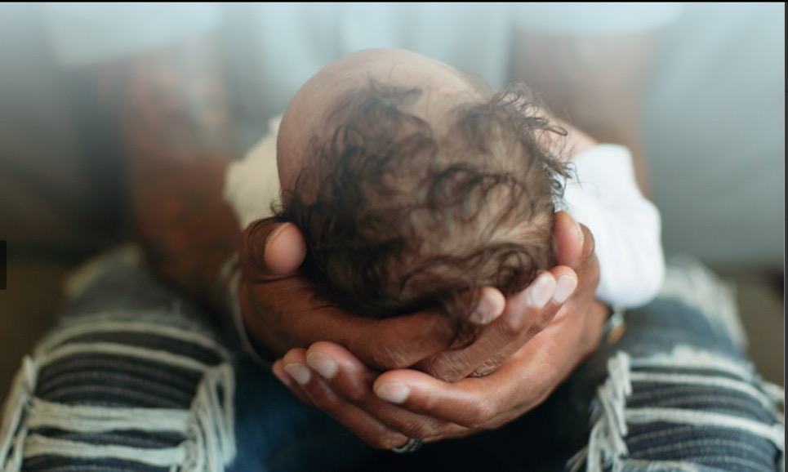
Parenting & Looking after Babies:
Learning the ICON Message

Slide 2



Parenting & Looking after babies - ICON
E.g. think about the emotions felt by a new parent or sibling
Entry Task – What do you think the positive and negative experiences are of looking after a baby?
Positive | Negative / Challenges
E.g. think about the challenges of being a new parent or sibling to a baby

Slide 3
Entry Task – What do you think the positive and negative experiences are of looking after a baby?
Positive | Negative / Challenges
Babies are cute You feel protective You feel proud Endorphins (cuddling babies releases happy hormones) | Tired / exhaustion (baby not sleeping) Nervousness / anxious about getting everything right Post labour pain (for the new mum) Sibling (feeling left out)

Slide 4
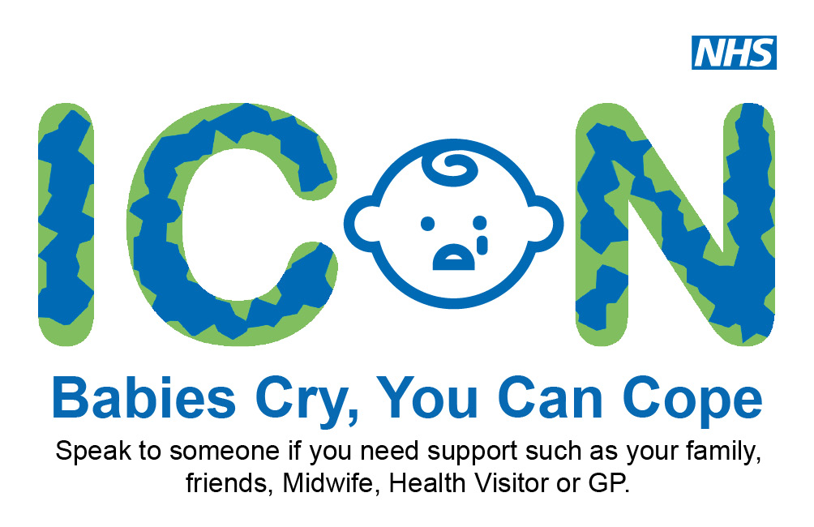
ICON – A programme designed to help parents with babies crying
Think, Pair, Share:
Why do you think babies cry?

Slide 5
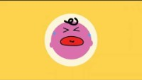

Slide 6
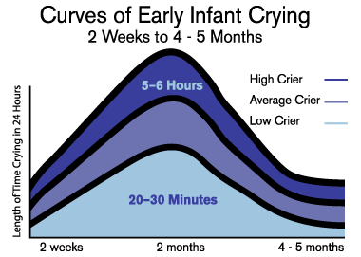
Although it may be upsetting, it is totally normal for babies to cry lots between 2 weeks and 5 months

Slide 7

Sometimes the crying can get too much for the care giver.
This can lead to them shaking or hurting the baby.
Abusive head trauma
Is often fatal to the baby
Causes brain damage
Shaking a baby can cause “abusive head trauma” also known as shaken baby syndrome

Slide 8
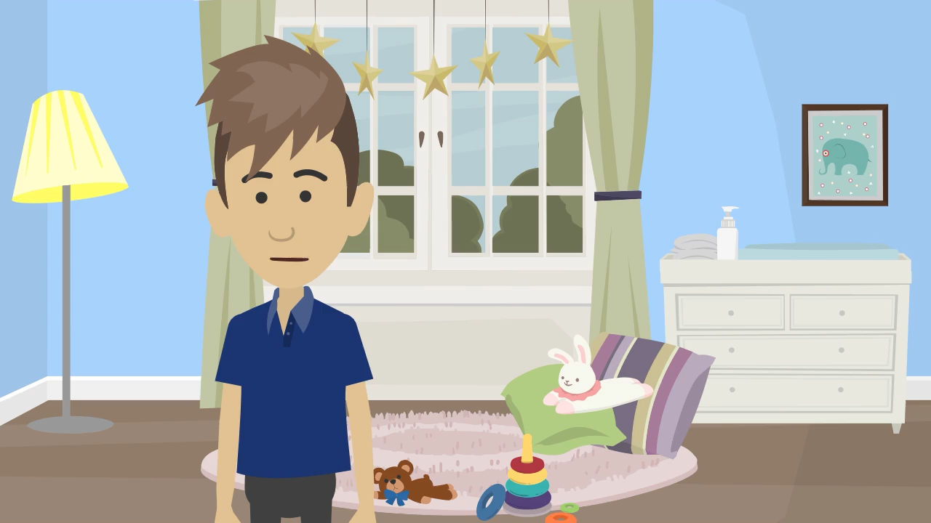
How do you think mum and dad felt in this video?

Slide 9
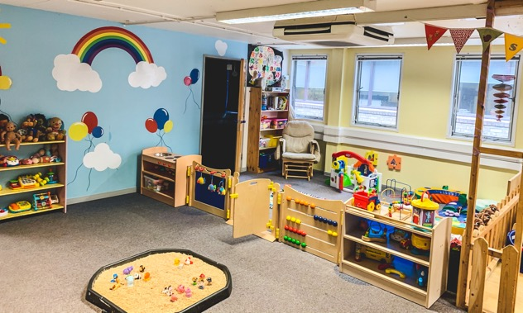

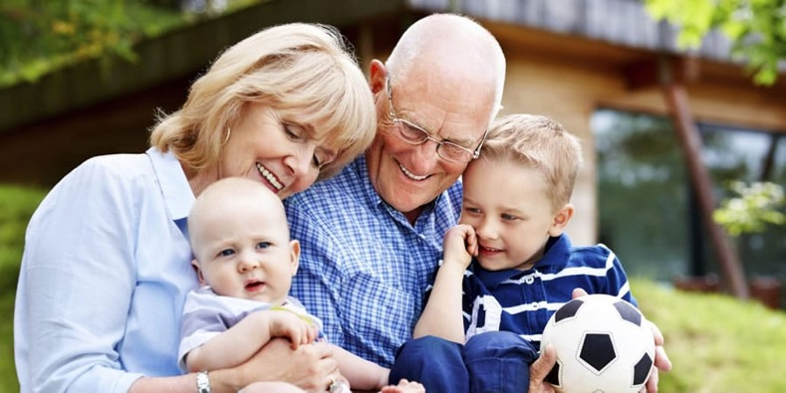
Who else may be looking after a baby?

Slide 10
Case Study: Ellis and Mae
Read the case study in your pairs and answer the following questions:
What were the long-term consequences for Ellis of him being shaken?
What were the long-term consequences for mum Mae?
What were the long-term consequences for the ex-partner?
How does this case study make you feel?
Why do you think it is important to educate people on this topic?

Slide 11
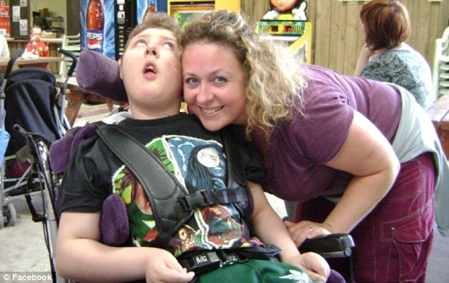
Mum Mae has bravely shared her story with us to help prevent this from happening to other babies

Slide 12
Case study:
Ellis and Mae
Ellis was born in Valentines day 1995. He was just perfect. 3 months later he was shaken by my ex-partner. This caused Ellis to stop breathing and he was rushed to hospital. I was really worried about him. He was in an incubator in the intensive care unit. I did not know Ellis had been injured.
Ellis had sustained severe brain damage as his brain had been shaken back and forth. He had become blind as the shake had caused his retinas to become detached and his optical nerves to be damaged. Ellis was very poorly and the doctors did not think he would survive. But he did.
It was then that my ex-partner was arrested and charged for shaking Ellis, as he had stopped breathing in his care. He went to prison. Ellis came home as a different baby. He no longer coo’d when I walked into a room or when I picked him up. He didn’t reach for things or play. Ellis didn’t move or make happy sounds.
As Ellis got older it became more obvious, what the damage had done to his brain. He didn’t learn to roll, or hold anything. He also didn’t start crawling or sitting himself up or standing and walk. He never spoke, not even basic words, I was never called mum. Instead, Ellis was in hospital more than he was at home, due to him being poorly or needing operations. His longest time in hospital was 17 weeks, mainly due to chest infections as he had a low immune system. He was in intensive care 5 times on a life support machine. I worried about him everyday of his life.
As Ellis got older it became more difficult look after Ellis. We had a hoist to get him in and out of bed, in and out of his special adapted wheel chair and in and out of the bath. Ellis could do nothing for himself. He couldn't move, talk, feed himself or even see. I had to do everything for him. He lost his right to chose, make friends or have a personality.
Elis kept being poorly, and was rushed to hospital more frequently with chest infections. His doctor told me that Ellis was reaching his end of life. We looked after him at home and had palliative nurses come and help us. Ellis passed away age 14 as I held his hand at a children’s hospice. His weak immune system was as a direct result of the catastrophic injuries Elis sustained.
Ellis would have been 27 now. May have got a job and had children of its own. One moment of anger took Ellis life away from him. I will always be affected by the loss of what should have been, the 14 years of trauma he went through. His younger brother will never have that brother to look up to. Our loss will be felt forever.
It’s vital to understand ICON and that future parents, babysitters, sibling etc. are all educated to truly know the severe consequences of shaking a baby.
Notes:
To be printed

Slide 13
Coping with babies crying
Remember crying is normal in babies
Think about whether they are; hungry, need their nappy changed, tired
Sing to the baby
Give the baby skin to skin contact (cuddle)
If possible, try going for a walk
If the baby is in a safe place, it is okay to walk away and calm down

Slide 14
Plenary: When can new parents access / ask for support
Ask their midwife or doctor
Ask their health visitor
Supporting new parents and siblings

Slide 15
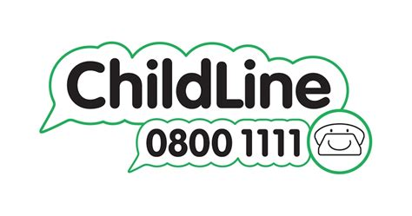
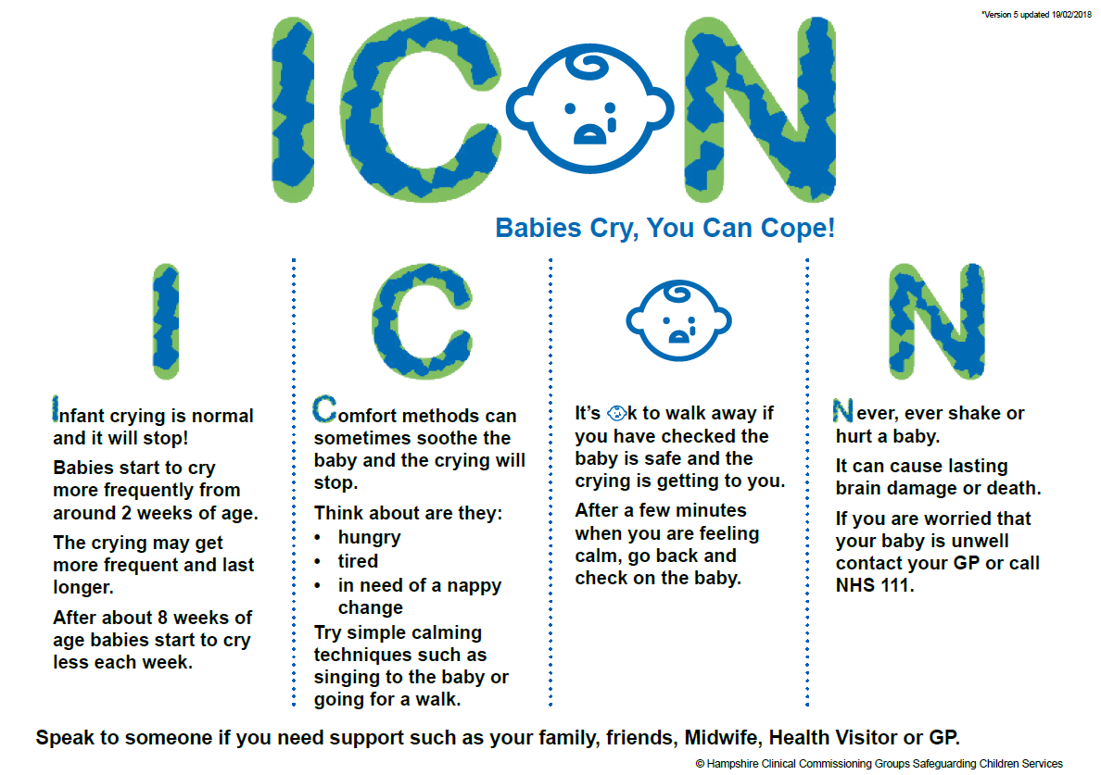


Slide 16
Teacher Notes Suitable for delivery to KS4 – ‘Parenting and looking after babies – ICON’
Core message
ICON is a programme designed to reduce the incidence of abusive head trauma in babies and toddlers. Research suggests that some lose control when a baby’s cry becomes too much. Some go on to shake a baby with devastating consequences.
The main aim of this lesson is to deliver the message that it is normal for babies to cry, support is out there, and that those looking after a baby should never shake them.
Signposting and Safeguarding
Please follow your school’s safeguarding procedure if a child discloses an incident or worrying behaviour in relation to this lesson. Before delivering the lesson speak to your DSL and pastoral team to ensure that the lesson will not have an adverse impact on any child that has experienced previous trauma.
Students can access support at home via Childline, 0800 1111 or via an online 1-2-1 counsellor chat: https://www.childline.org.uk/get-support/1-2-1-counsellor-chat/
Please visit https://iconcope.org/ for extra information and signposting. NHS 111 can be used if someone is unsure on whether they or someone else needs medical intervention if a child is concerned about.
Links to further information
Swaddling your baby and using slings - The Lullaby Trust
How to reduce the risk of SIDS for your baby - The Lullaby Trust
Support For Crying And Sleepless Babies | Cry-sis
Soothing a crying baby - NHS (www.nhs.uk)

Slide 17
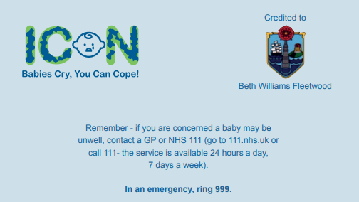

Slide 18
